Slide 1
Last Week
This Week
2D Power Splitter with tapers
2D Power Splitter with tapers

Slide 2
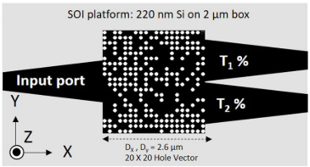
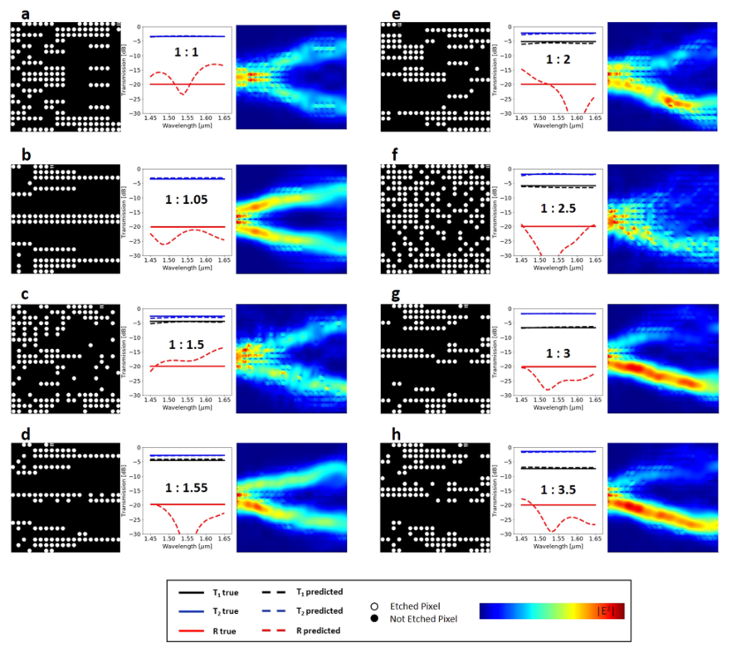
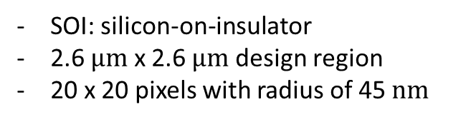
2019-Scientific Reports-9, 1368-Deep Neural Network Inverse Design of Integrated Photonic Power Splitters (Mohammad H. Tahersima, Keisuke Kojima, Toshiaki Koike-Akino, Devesh Jha, Bingnan Wang, Chungwei Lin, Kieran Parsons)
SOI: silicon-on-insulator
2.6 $μm$ x 2.6 $μm$ design region
20 x 20 pixels with radius of 45 $nm$

Slide 3
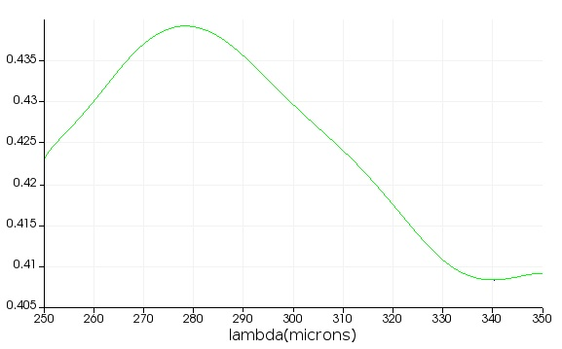
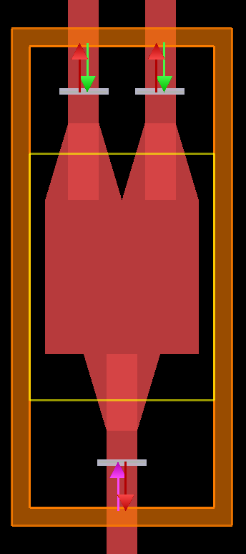
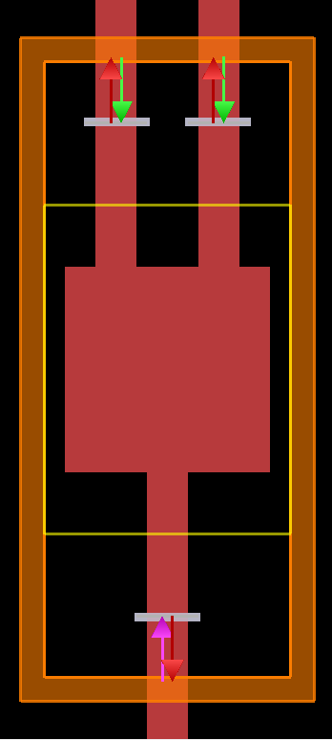
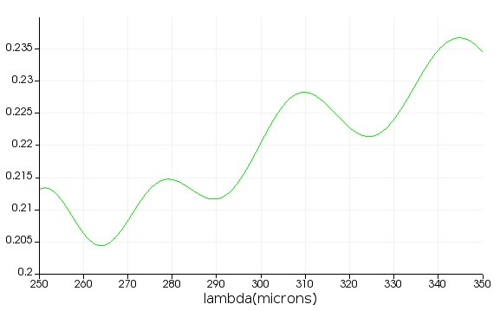
2D Power Splitter – FDTD Setting
Output 1&2
(b)-1
(a)-1
(a)-2
(b)-2
Simulation region: 250 ~ 350 um
Waveguide thickness: 100 um
Square: 500 um x 500 um
Taper connection: 250 um
Holes: 20x20 with a radius of 9 um

Slide 4
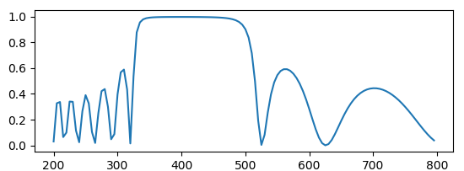
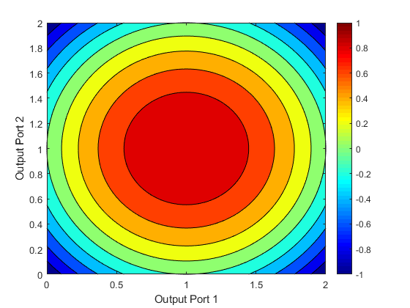
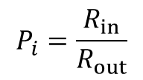


2D Power Splitter – Machine Learning Setting
Example
Bandwidth: 100
$$P_{i}=\frac{R_{in}}{R_{out}}$$
$R_{in}$: mean(inside bandwidth)
$R_{out}$: mean(outside bandwidth)
FOM
$$FOM=1−\left({\left(P_{1}−1\right)}^{2}+{\left(P_{2}−1\right)}^{2}\right)$$
$$FOM=1−\sqrt{{\left(P_{1}−1\right)}^{2}+{\left(P_{2}−1\right)}^{2}}$$

